Slide 1
Chapter 17.
Connecting LANs, Backbone Networks, and Virtual LANs
17.1 Connecting devices
17.2 Backbone networks
17.3 Virtual LANs
Computer Networks
15-<number>

Slide 2

Five Categories of Connecting Devices
Below the physical layer: passive hub
At the physical layer: repeater or active hub
At the physical and data link layers: bridge or two-layer switch
At the physical, data link, network layers: router or three-layer switch
At all five layers: gateway
Computer Networks
15-<number>

Slide 3

Repeater
Repeater
A repeater operates only in the physical layers
A repeater connects segments of a LAN
A repeater forwards every frame; it has no filtering capability
The repeater is a two-port device that extends the LANs’ physical length
Computer Networks
15-<number>

Slide 4

Function of a Repeater
A repeater is a regenerator, not an amplifier
Computer Networks
15-<number>

Slide 5

Active Hubs
An active hub is actually a multiport repeater
It is normally used to create connections between stations in a star topology
Hubs can also be used to create multiple levels of hierarchy; removing the length limitation of 10Base-T (100m)
Computer Networks
15-<number>

Slide 6
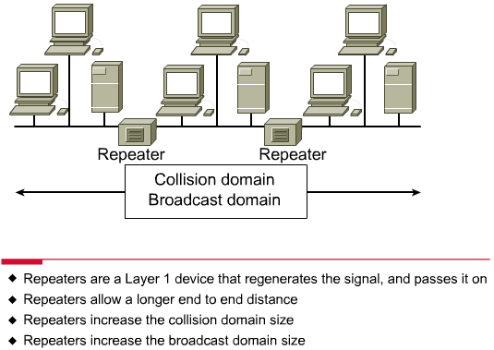
Repeaters/Hubs
Computer Networks
15-<number>

Slide 7
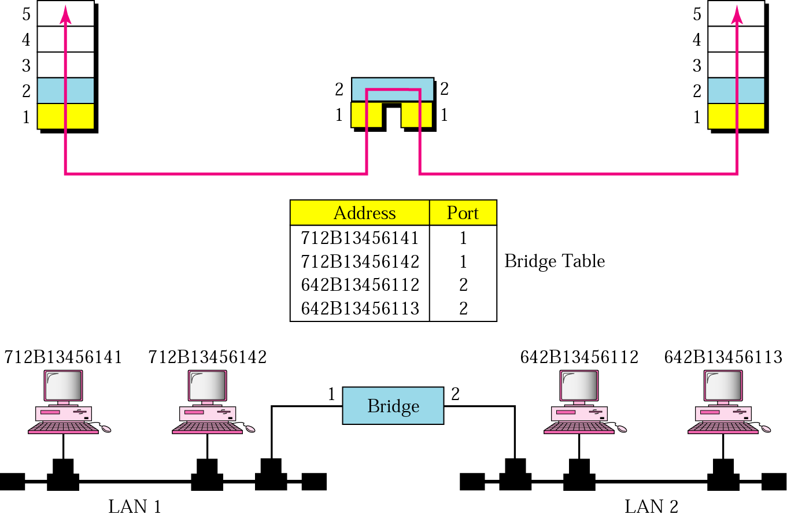
Bridges
A bridge operates in both physical and data link layers
A bridge has filtering capability: Having a table used in filtering decisions
A bridge can check, does not change the physical (MAC) addresses in a frame
Computer Networks
15-<number>

Slide 8
Bridges
Transparent bridges
  A bridge in which the stations are completely unaware of the bridge’s existence
  Three criteria for a transparent bridge
    Frames must forward from one station to another
    The forwarding table is automatically made by learning frame movements in the network
    Loops in the system must be prevented
Source routing bridges
  A sending station defines the bridges that the frame must visit
  Not very common today
  It can prevent loops in a system with redundant bridges
Computer Networks
15-<number>

Slide 9

Transparent Bridges: Learning
Computer Networks
15-<number>

Slide 10
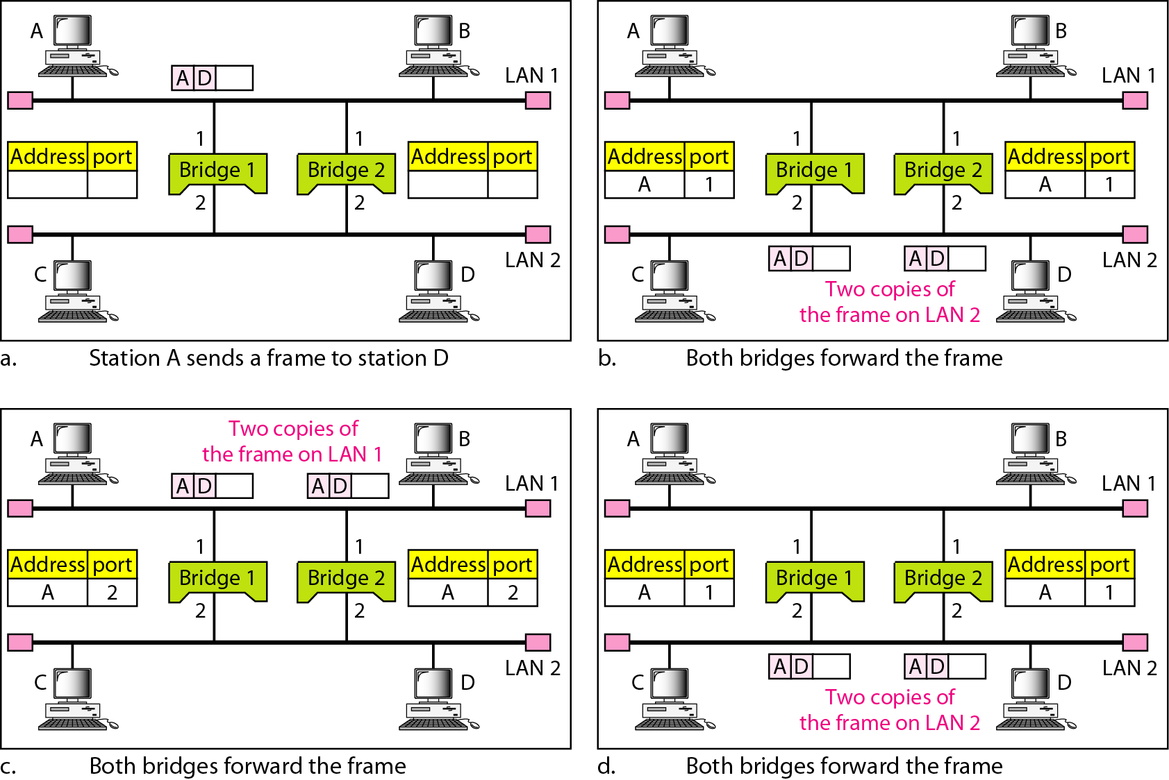
Loop Problem in a Learning Bridge
Computer Networks
15-<number>

Slide 11
Transparent Bridges: Spanning Tree
Spanning tree is a graph in which there is no loop
To solve the looping problem, IEEE spec requires that bridges use the spanning tree algorithm
Select the root bridge
  The one with the smallest built-in ID
Select the root port of each bridge
  The port with the least-cost path from the bridge to the root bridge
Choose a designated bridge for each LAN
  The bridge with the least-cost path from the LAN to the root bridge
  The corresponding port is the designated port
4. Mark the root port and designated port as forwarding port, others as blocking port
Computer Networks
15-<number>

Slide 12
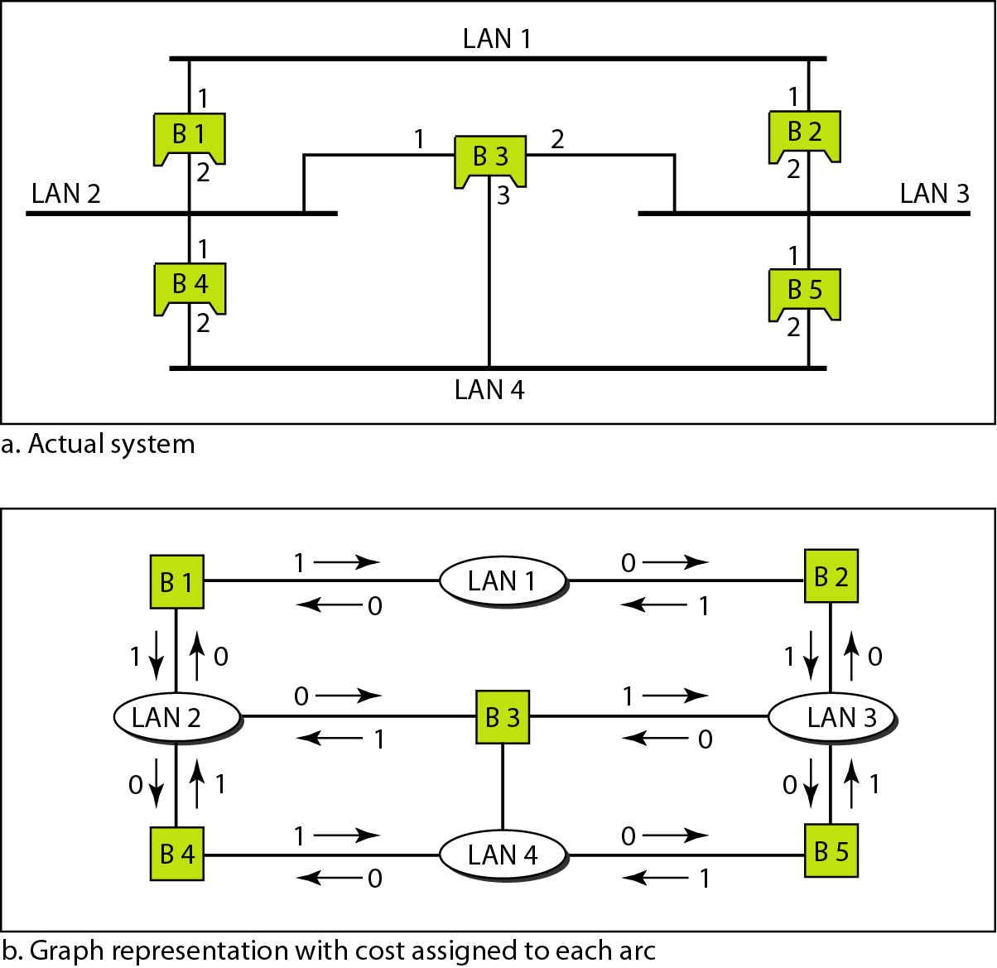
Spanning Tree: Graph Representation
Computer Networks
15-<number>

Slide 13
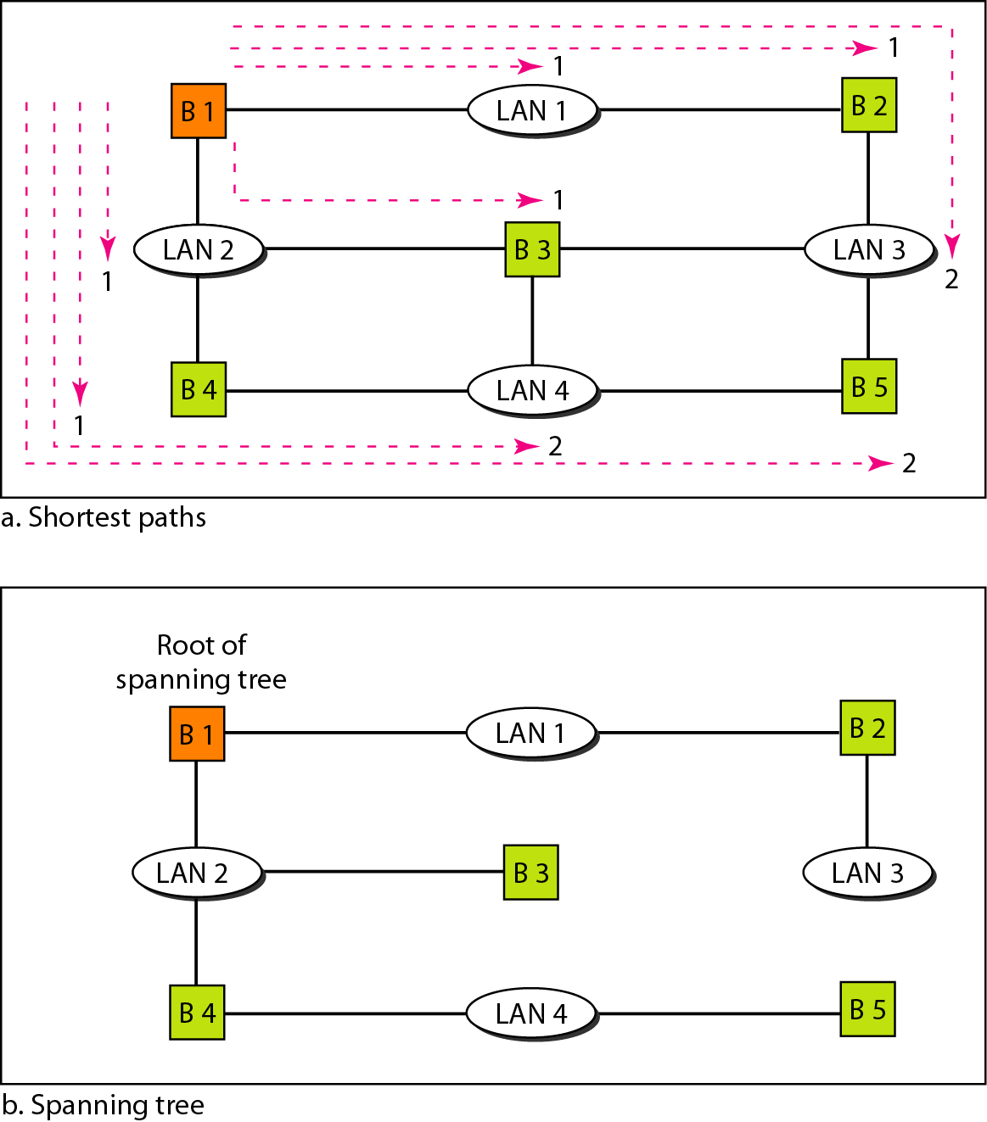
Spanning Tree:Finding the Shortest Path
Computer Networks
15-<number>

Slide 14
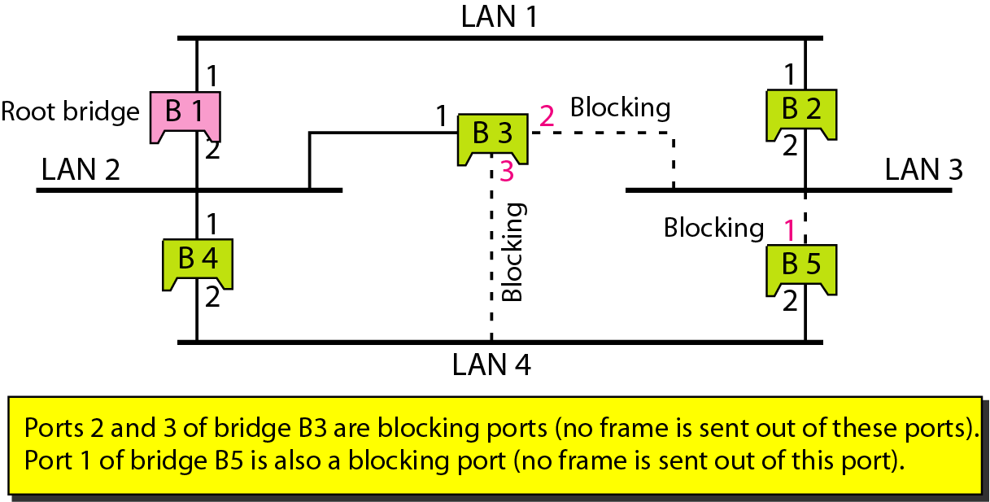
Spanning Tree: Forwarding and Blocking Ports
Computer Networks
15-<number>

Slide 15
Bridges Connecting Different LANs
Many technical issues to connect LANs using different protocols at the data link layer
Frame format
Maximum data size
Data rate
Bit order
Security
Multimedia support and QoS
Computer Networks
15-<number>

Slide 16
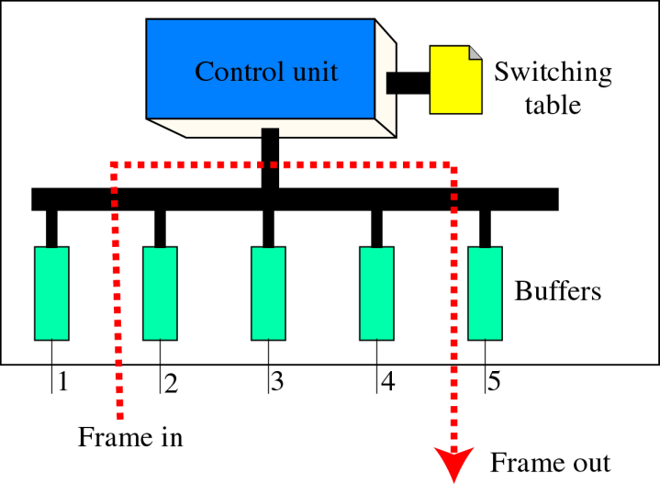
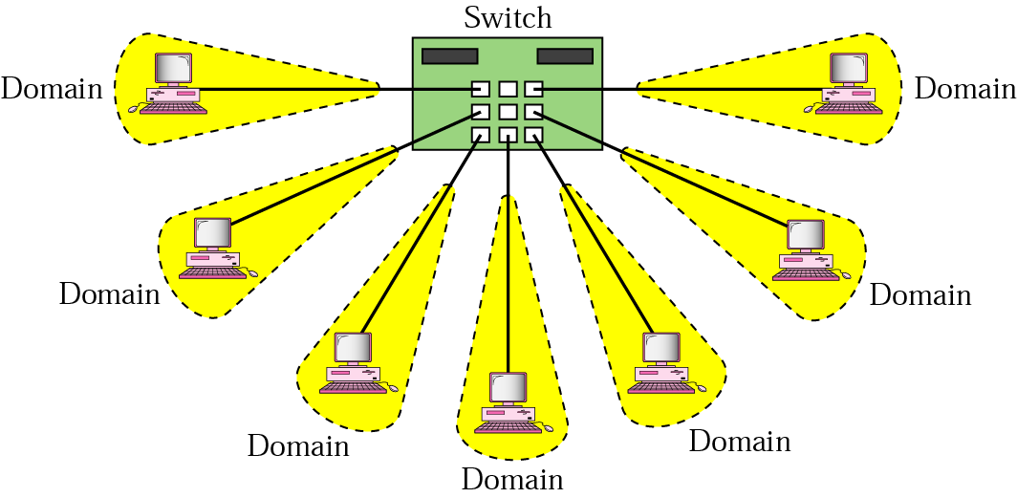
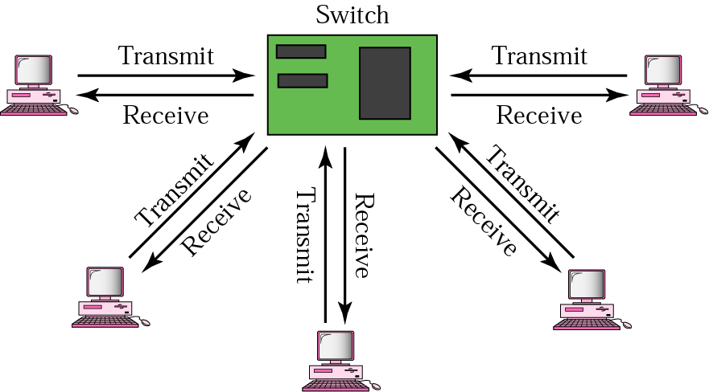
Two-Layer (Layer 2) Switch
Layer 2 switch is an N-port bridge
Ethernet switch or LAN switch
Switched Ethernet (←)
Full-duplex switched Ethernet (↓)
Computer Networks
15-<number>

Slide 17
Two-Layer and Three-Layer Switch
Two-Layer Switch : bridge with many ports
  Filtering based on the MAC address of the frame it received
  Builds switching table by “learning” host addresses from source addresses of incoming packets
  Unknown destination addresses are flooded out other ports
  Broadcast frames are flooded out other ports
Router
  Three-layer device that routes packets based on their logical (network layer) address.
  Builds routing table by neighbor routers using routing protocols
  Unknown IP packets are discarded
  Broadcast frames are discarded
Three-Layer Switch : a router, but a faster and more sophisticated
  Router and three-layer switch interchangeably
Computer Networks
15-<number>

Slide 18
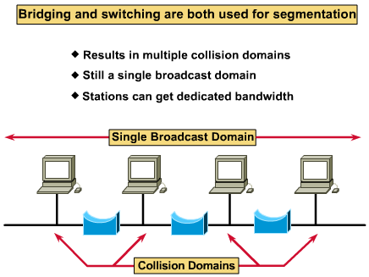
Broadcast and Collision Domains
Computer Networks
15-<number>

Slide 19
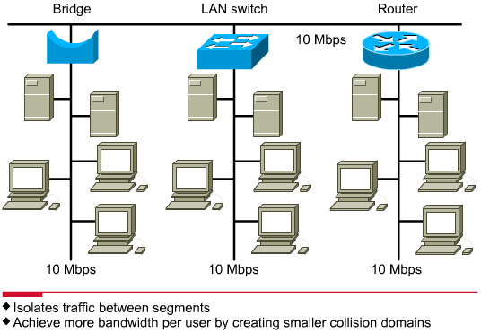
LAN Segmentation
Computer Networks
15-<number>

Slide 20
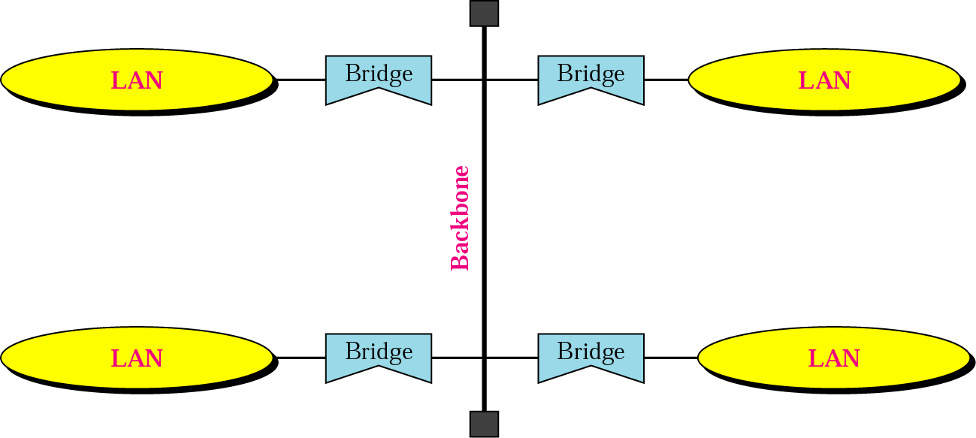
Backbone Network: Bus Backbone
The topology of the backbone is a bus
To connect different buildings in an organization
Computer Networks
15-<number>

Slide 21
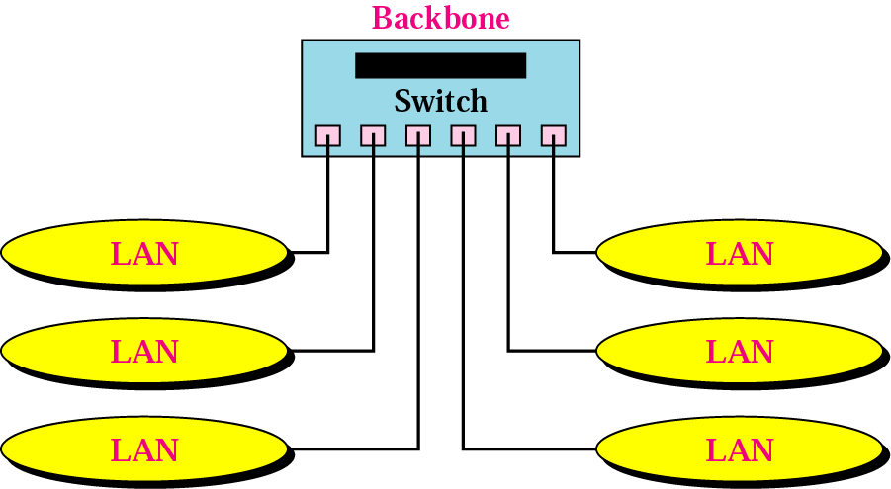
Star Backbone
Collapsed or switched backbone
The topology of the backbone is a star; the backbone is just one switch
Mostly used as a distribution backbone inside a building
Computer Networks
15-<number>

Slide 22
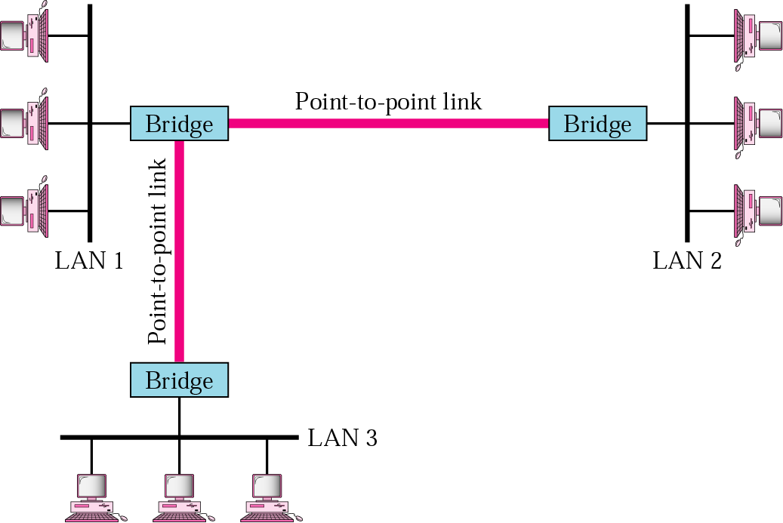
Connecting Remote LANs
When a company has several offices with LANs
Remote bridges
A point-to-point link acts as a LAN in a remote backbone connected by remote bridges
Computer Networks
15-<number>

Slide 23
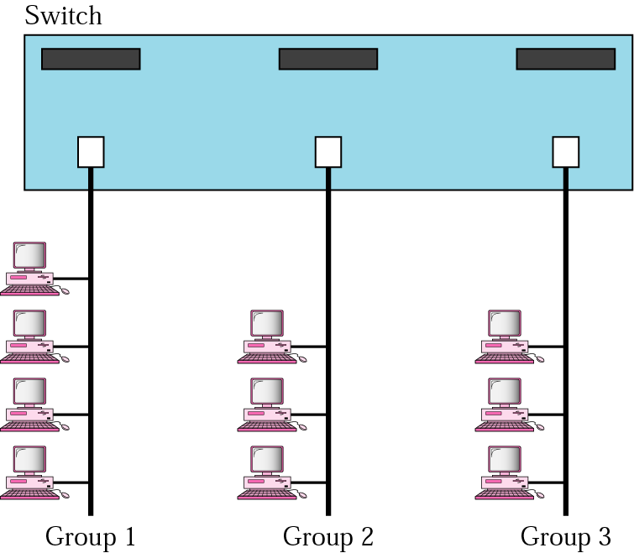
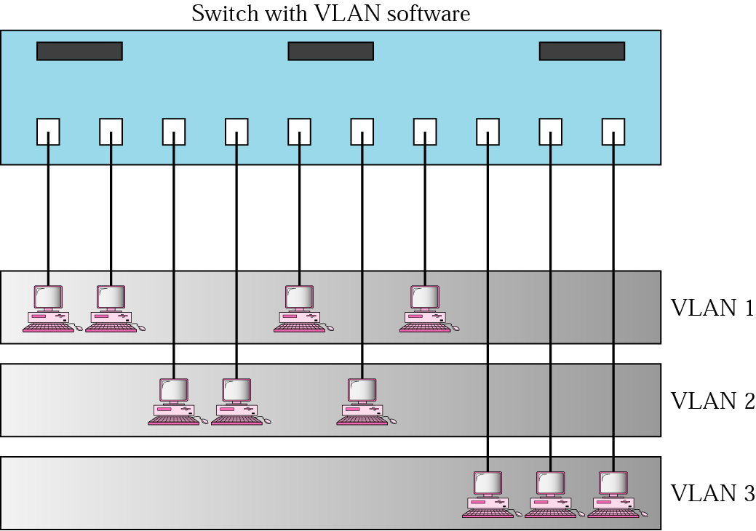
Virtual LANs
LAN configured by software, not by physical wiring
VLANs create broadcast domains
Computer Networks
15-<number>

Slide 24
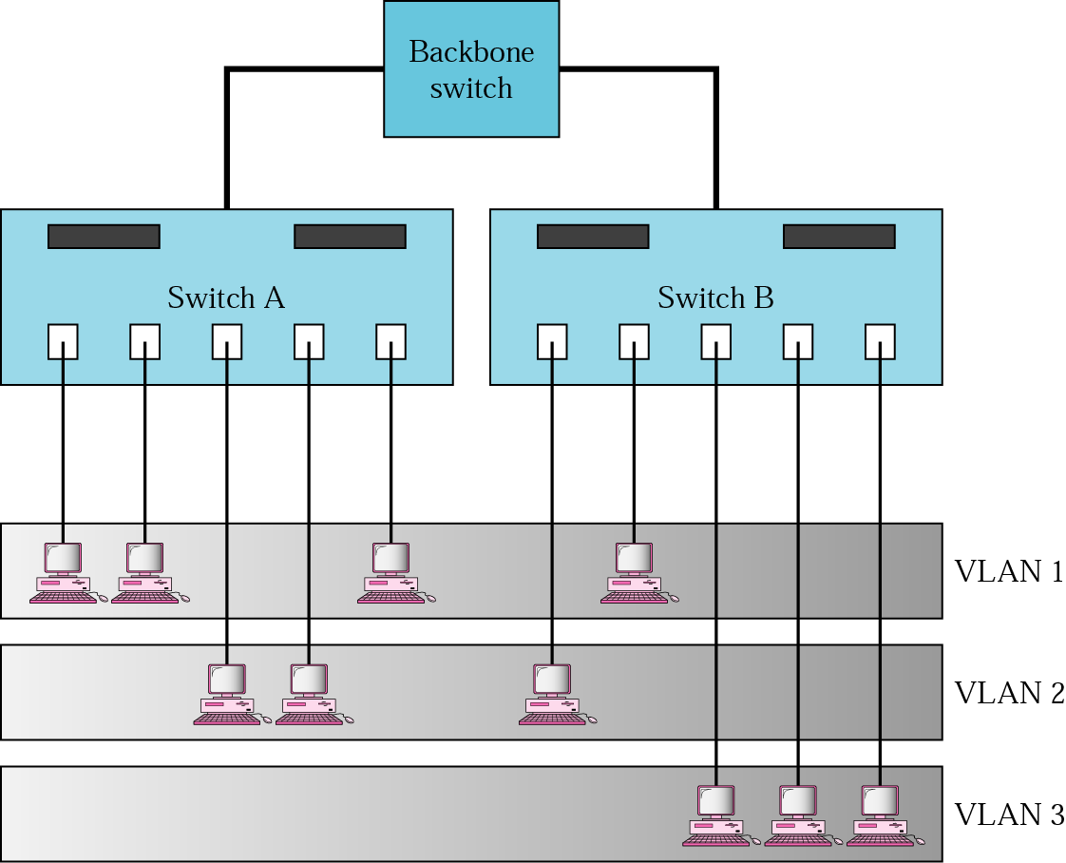
Example
Membership is characterized by port numbers, MAC addresses, IP addresses, multicast IP addresses or a combination of the above
Computer Networks
15-<number>

Slide 25
VLAN
Membership
  Membership is characterized by port numbers, MAC addresses, IP addresses, Multicast IP addresses, or a combination of the above
Configuration
  VLAN can be configured in one of three ways: manual, semiautomatic, and automatic
Communication between switches
  Each switch must know not only which station belongs to which VLAN, but also the membership of stations connected to other switches
  Three methods are devised: table maintenance, frame tagging, and TDM
Advantages of VLAN
  Cost and time reduction
  Creating virtual workgroups
  Security
Computer Networks
15-<number>

